Slide 1

Caterpillars
Plans and expectations!

Slide 2
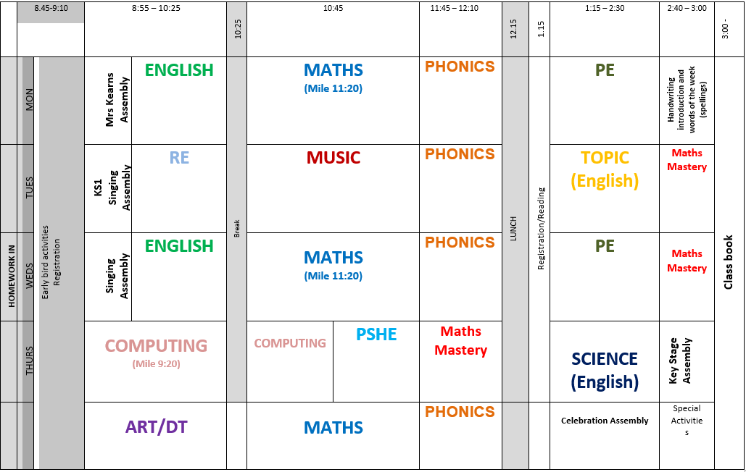

Slide 3
PHONICS
Four 20 minute lessons a week
Revisiting sounds, especially digraphs and trigraphs, until half term.
Beginning phase 5 after half term.
Phonics Check will take place next June.

Slide 4
SPELLINGS
New scheme across the school last year, CUSP, focussing more on the patterns and rules within spellings and using them within writing.
There will not be a ‘test’ on a Friday, more a continual absorption for want of a better word throughout the week!
In the last 2 weeks of each half term there will be a 2 week spelling programme that will replace phonic lessons and revisit all spellings over that half term. In those 2 weeks there will be some activities for children to do at home as well.
Each week I will post our focus words on seesaw so if you want to talk about them at home you can! ( If spelling out loud please use the names of the letters not the sounds).
We will still have keywords, these will be for sight reading only, and go upto set 30 ( but no extra spellings every 5).

Slide 5
READING
As last year we will be changing books on a Friday - 2 physical books. I will also post a variety of e-books for you to use ach half term to supplement the books if you want to use them.
We will strive listen to every child read each week ( minimum fortnightly)
Keywords will continue to come home as well.
Please remember the importance of talking about what the child has read…when the comprehension is there we will be able to look at testing the children and moving them onto trickier books!
Please read regularly at home!
Reading buddies on a Friday will write in your child’s reading log, hopefully with a positive comment!

Slide 6
Snack time
Free fruit is still available until the end of year 2.
If you want to send in fruit for your child that is fine, they can pop it in their drawer for snacktime.

Slide 7
PE
PE will be on a Monday and Wednesday afternoon.
PE will be mostly indoors until the spring as we will be following the real PE and real gym lesson scheme and obviously the weather will be on the change soon!
Children need trainers and shorts for PE. Only children wearing tights need to change socks.
Only one session a week after half term as we will be into rehearsals for nativity!!!
We will keep PE kits on school, however if your child wears it home because of doing a club, please remember to send back in!
PE kits will be sent home each half term for a good wash!

Slide 8
SEESAW
We will be using seesaw for sharing things that go on in class – work/ activities etc.
You can share out of school achievements and work etc by posting on your child’s journal.
I can send announcements – quick reminder notes about what is coming up etc.
You can also message me instead of emailing …I try to check my messages every day!
See-Saw-Parent-leaflet.pdf (andover-pri.hants.sch.uk)

Slide 9
Dates for your diary!
Thursday 3rd October – Ludlow castle trip.
Thursday 10th October – Harvest Festival at the church.
Thursday 17th October, 2:30pm. Class Assembly.
Nativity – Tuesday 3rd December 2pm
Wednesday 4th December 5:30 pm

