Slide 1
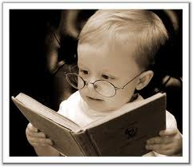
Learning to read!
Stephanie Austwick
Independent Literacy Consultant

Slide 2
Aims of this evening
To explore the teaching of phonics and early reading (and writing) in primary schools.
To consider the importance of comprehension in reading.
To consider how we can support children in their learning.
Notes:
Introduce myself and outline session

Slide 3
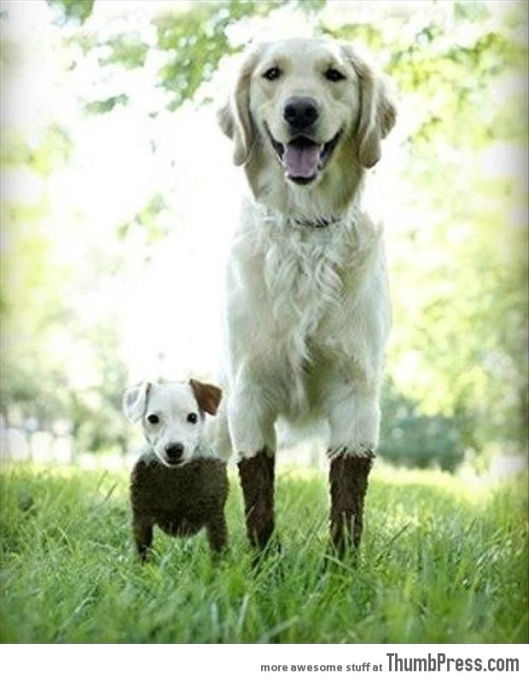

Slide 4

Why is learning to read so important?
A growing number of studies show that promoting reading can have a major impact on children and adults and their future.
Evidence suggests that reading for pleasure leads to increased attainment.

Slide 5
Reading:
encourages thinking and develops curiosity
expands vocabulary
improves writing skills and spelling
provides pleasure, relaxation and entertainment
develops general knowledge
inspires and motivates
enhances social skills
improves concentration
builds self-confidence
gives a greater insight into human nature and decision-making
opens doors to the world! and lots more…

Slide 6
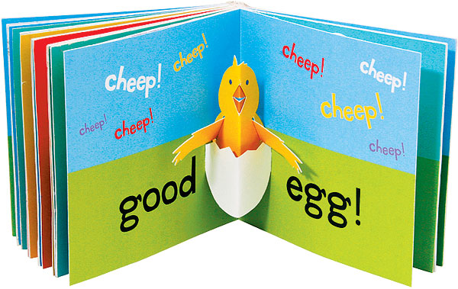

Learning to read involves 2 things:
word recognition
+ language comprehension
decoding /
reading the words on the page
understanding what you
have read

Slide 7

word recognition
+
language comp

Slide 8

word recognition
+
language comp
word recognition
+
language comp

Slide 9
word recognition
+
language comp
word recognition
+
language comp
word recognition
+
language comp

Slide 10
word recognition
+
language comp
word recognition
+
language comp
word recognition
+
language comp
word recognition
+
language comp

Slide 11
Learning to read (and write)
Do you remember what it was like?

Slide 12
Notes:
a i
m n
p s
t

Slide 13
Now you can read whole words
Notes:
pat
tins
stamp

Slide 14
Now you can read whole sentences!
Notes:
I sat in a tin

Slide 15
Knowing the terminology of phonics!
phoneme - sound
grapheme - written form
digraph - 2 letters = 1 sound e.g. ee
split digraph - two letters – split up (magic e!)
trigraph - 3 letters = 1 sound e.g. igh
segmenting - splitting up into phonemes (to spell)
blending - running phonemes together (to read)
cvc words - consonant/vowel/consonant e.g. c-a-t
syllables - chunks of a word e.g. yes-ter-day
tricky words – words that you DON’T sound out, e.g. to
Notes:
Briefly mention terminology

Slide 16
Why is English so hard?

Slide 17
The main problems
There are only 26 letters in our alphabet
BUT
We need to make 44 sounds (or‘phonemes’) in the English language - we haven’t got enough letters!
SO
We have to use pairs or groups of letters together to represent the other sounds.
There are lots of rules – but most of them can be broken!
English is not a phonetic language.

Slide 18
Also…
Some phonemes can be written in many different ways
e.g. ee (tree) ea (read) e (he) e_e (here) …
Some letters can be used to make different sounds
e.g. c (cat, mice) g (go, giant)
Some combinations of letters can make different sounds
e.g. ough ( though, through, tough, thought)
Sometimes knowledge of phonics isn’t enough.

Slide 19
Reading Test!
broasted
phostiggle
steelornation
enough
Notes:
Don’t be surprised when your children struggle.

Slide 20
The Reading Journey

Slide 21
The 3 stages of reading development:
1. Getting ready to read – play, experience, talk
2. Learning to read - phonics and early reading skills
3. Developing comprehension, confidence and
enjoyment

Slide 22
1. Getting ready to read

Slide 23
Playing
Experiencing the world
Developing imagination
Engaging in discussion
Building vocabulary
Enjoying books, songs and rhymes
Reading the pictures
Role play

Slide 24
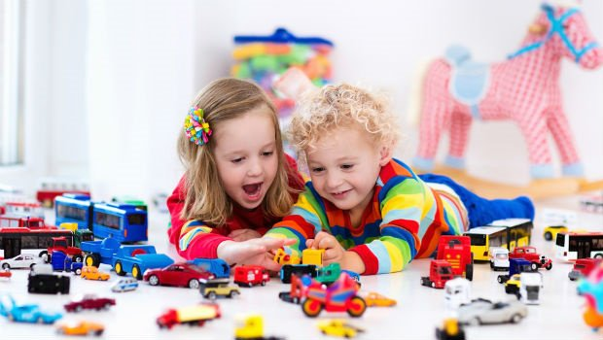

Slide 25
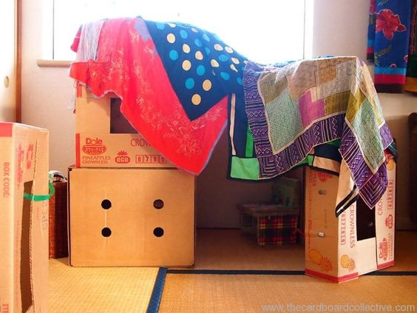
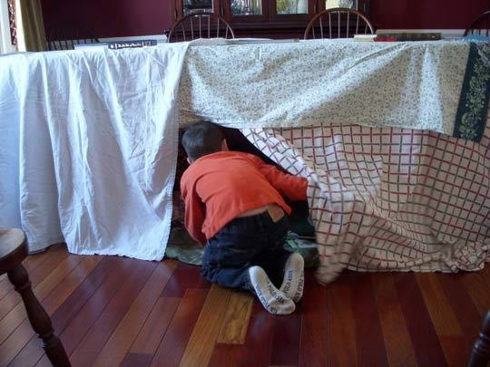
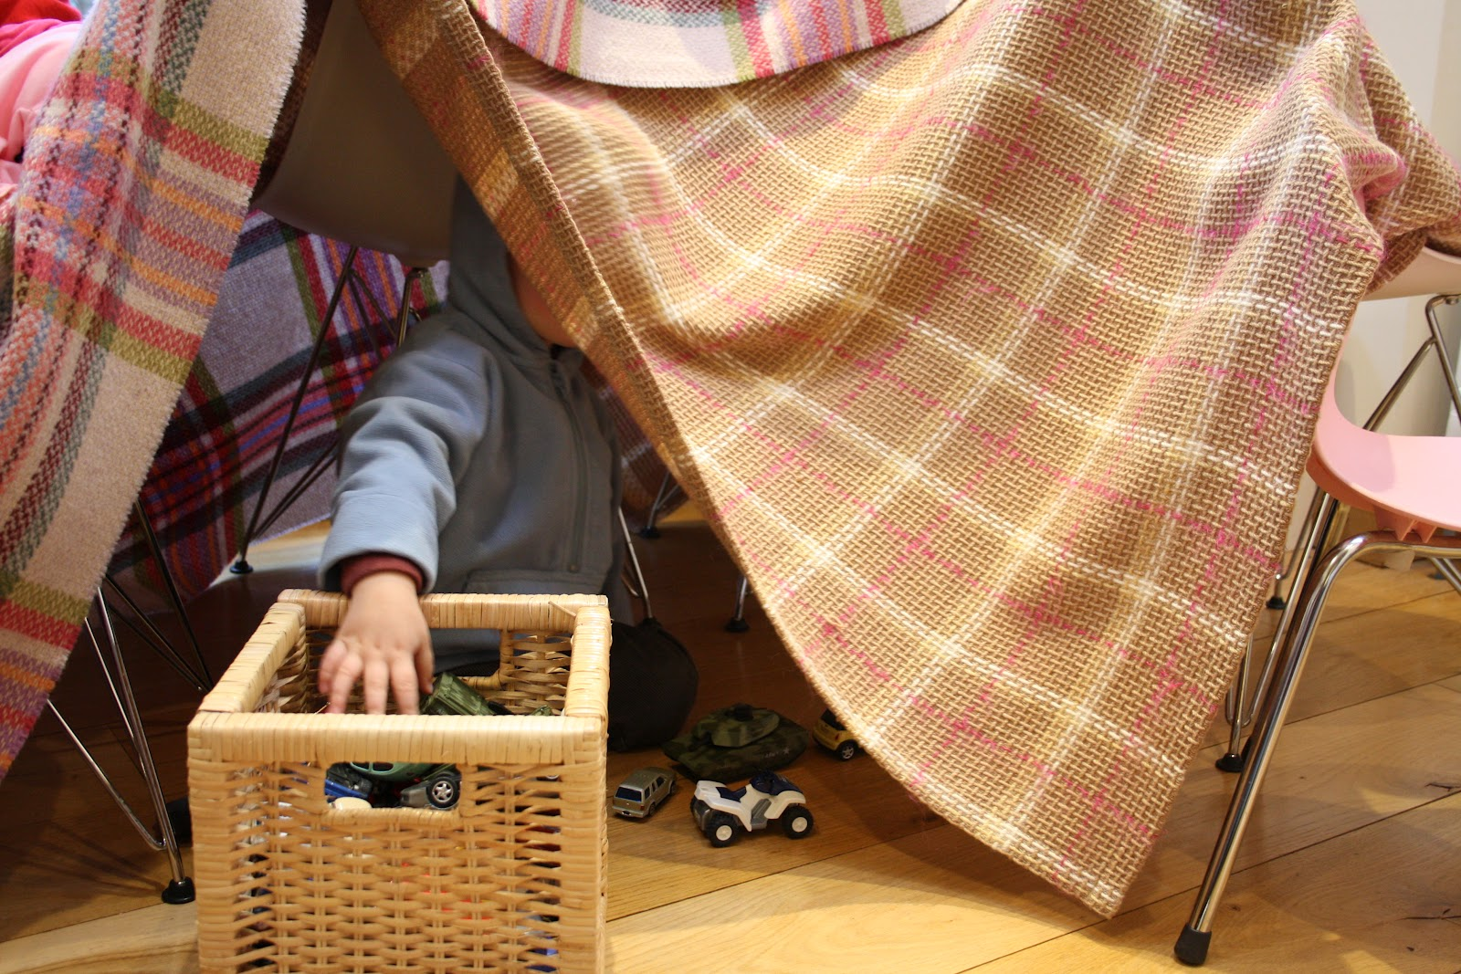
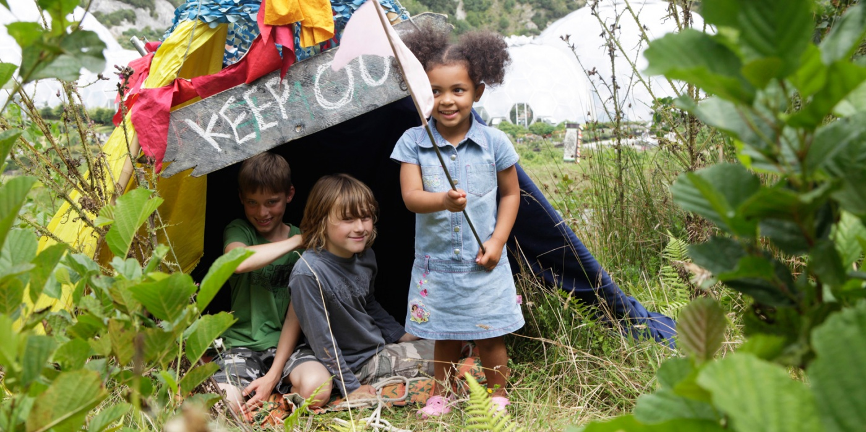
Dens

Slide 26
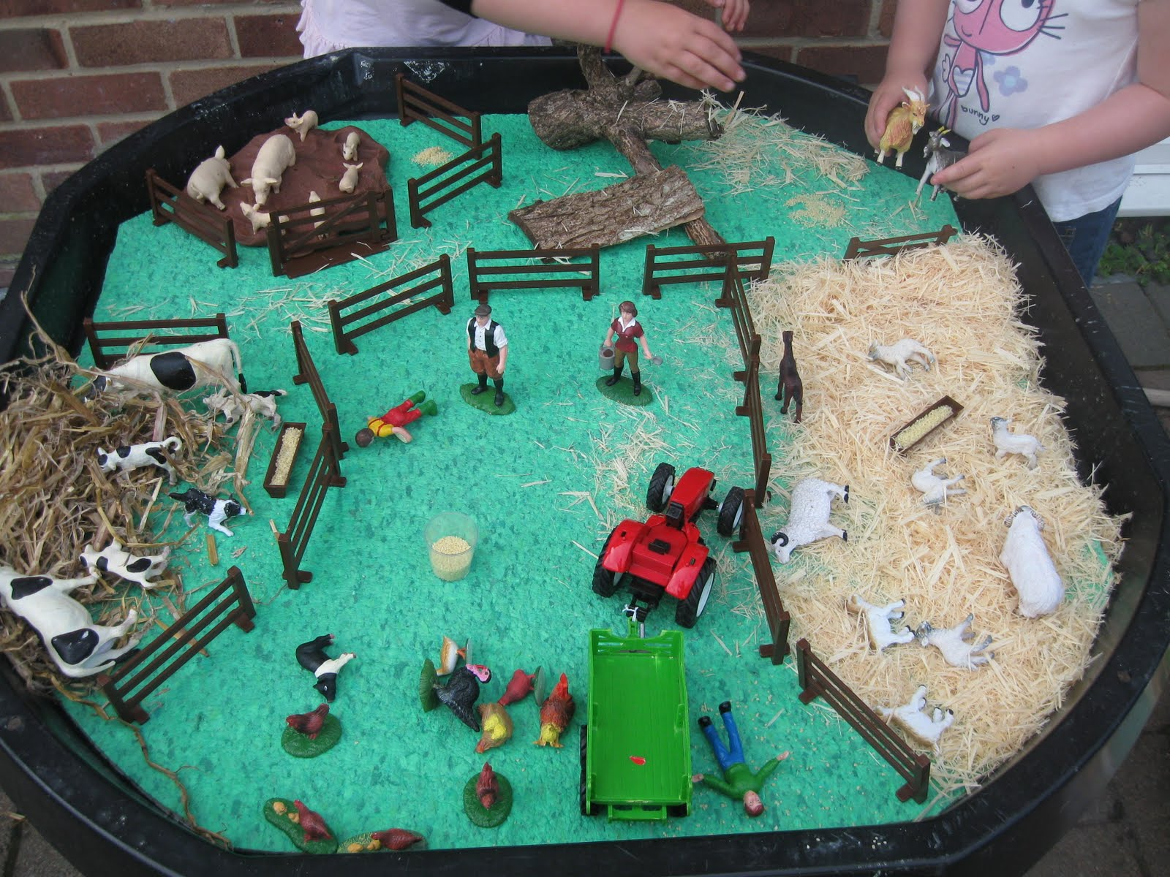
What colour is the tractor?

Slide 27
2. Learning to Read
– phonics and early reading skills

Slide 28
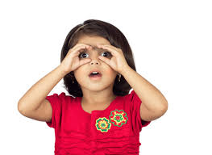
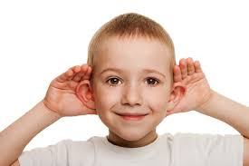
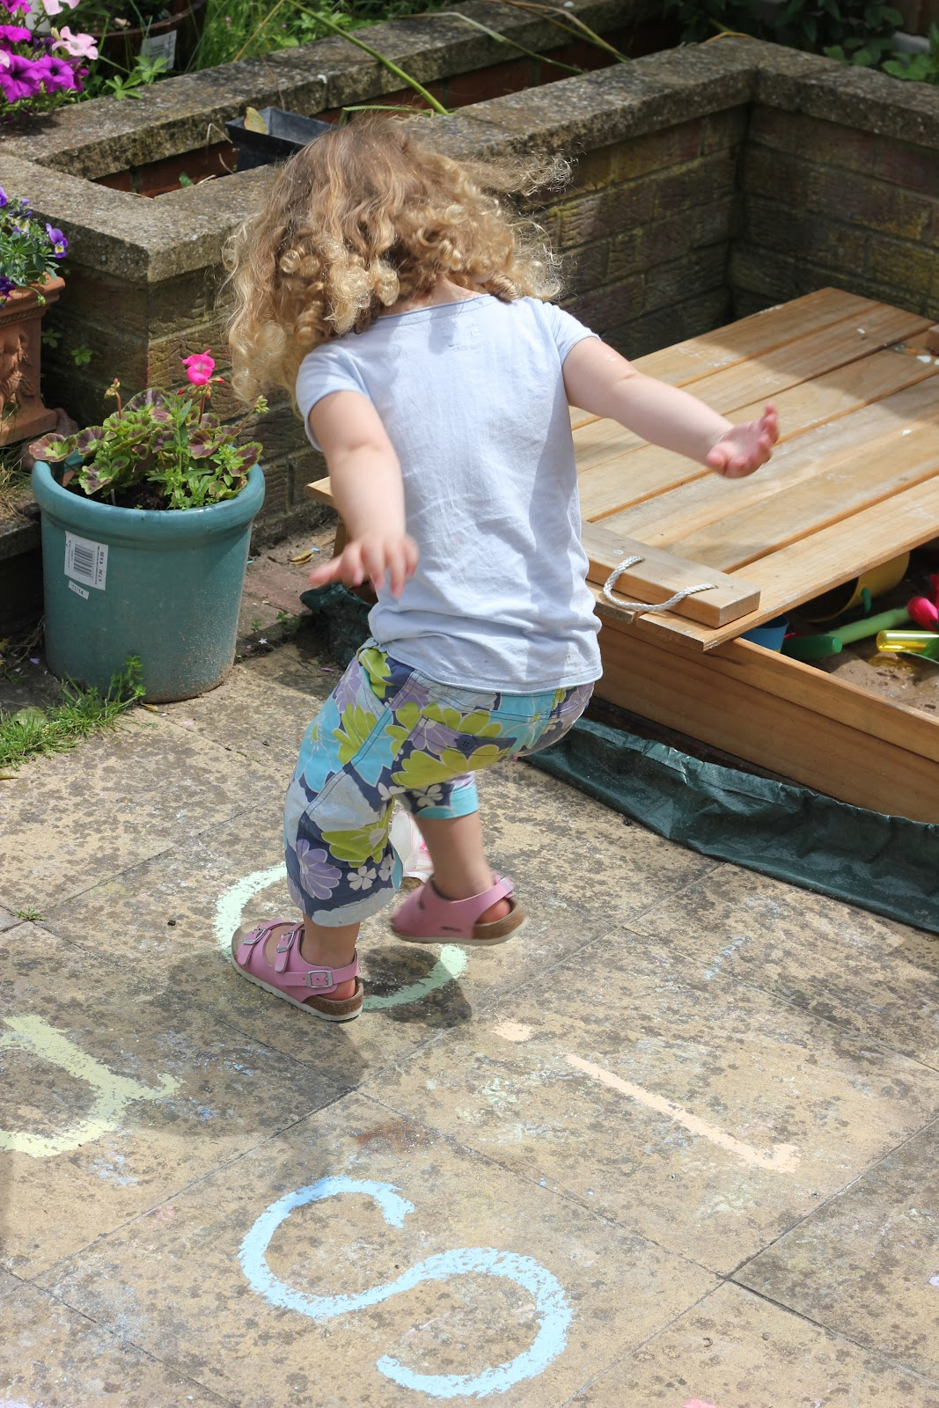
Learning Styles - VAK visual auditory kinaesthetic

Slide 29
Letters and Sounds
Structured phonic programme
6 phases

Slide 30
Phase 1
Lots of play, and practical activities to help children to:
listen attentively
speak confidently to adults and other children
expand their vocabulary
hear and discriminate between phonemes
reproduce the phonemes they hear
orally segment words into phonemes
Notes:
Robot talk – c-a-t cat
m-a-t mat

Slide 31
Phase 1
Activities that encourage children to :
1: listen to sounds around them – in the environment
2: listen to sounds around them – made by instruments
3: listen to sounds around them – body percussion
4: listen to, and join in with, rhythm and rhyme
5: hear alliteration – big brown bear
6: experiment with voice sounds – humming, whispering
7: oral blending and segmenting – ‘robot talk’- c-a-t cat

Slide 32
Phase 2
19 letters of alphabet – one sound for each
Segmenting and blending of simple words of one or two syllables
eg. s-a-t s-i-t s-u-n sunset
Simple ‘tricky’ words
e.g. the to no go I into

Slide 33
s a t p i n
In 20 seconds, how many words can you make?

Slide 34
Pronunciation of phonemes

Slide 35

Bouncy sounds
a b c d e g h i
j k o p q t u w
x

Slide 36
Blending
b u t
t a p
c o t

Slide 37
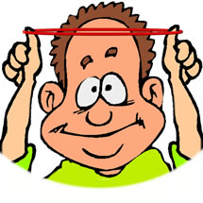
S t r e t c h y sounds
fffffffffff llllllllllllll
mmmmm nnnnnn
rrrrrrrrrrr sssssssssss
vvvvvvvvv zzzzzzzzzz
(yyyyyyy)
Voiced/unvoiced? Lips, teeth, tongue…

Slide 38
Blending
l a p
r a n
m a t

Slide 39
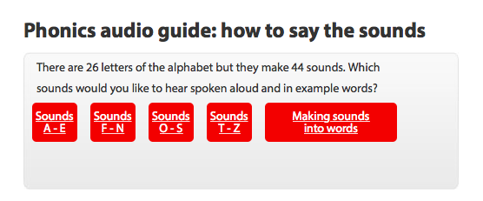
Oxford Owl - OUP

Slide 40
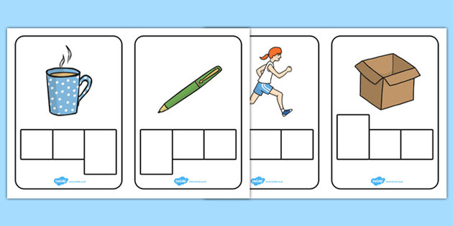
How many phonemes?
cat
c-a-t = 3
stop
s-t-o-p = 4
ship
sh-i-p = 3

Slide 41
Tricky words (= sight words)
the
to
no
go
into

Slide 42
Phase 3
7 more letters
Some digraphs (phonemes with two letters) e.g. sh ch oo ck
Blending and segmenting words with digraphs e.g. chip moon
More high frequency words
e.g. he she me be was

Slide 43
Phase 4
No new phonemes
Blend and segment words with adjacent consonants
e.g. w-e-n-t s-t-a-n-d sh-r-i-n-k
More tricky/ high frequency words
e.g. said have like some

Slide 44
Phase 5
More alternative graphemes for the phonemes taught in phases 2 and 3
e.g. long ‘a’ = ai, ay, a-e
More ways of pronouncing graphemes taught in phases 2 and 3 e.g. ow cow throw
Blend and segment all sounds taught
More high frequency words,
e.g. their where who though

Slide 45
Phase 6
Increasingly fluent segmenting and blending
Phonemes that can be spelt in more than one way, e.g. see/sea bed/head/said cloud/clown
Spelling rules:
prefixes and suffixes e.g. -ing
doubling and dropping of letters, e.g. hop/hopping
spelling of unusual words e.g. laugh, could

Slide 46
Ooooh! Here we go again!
Notes:
pat
tins
pints

Slide 47
Ooooh! Here we go again!
Be patient!
Notes:
pat
tins
stamp

Slide 48
3. Developing comprehension, confidence and
enjoyment

Slide 49

For success, attitude is as important as ability!

Slide 50
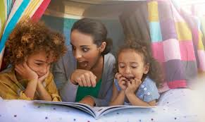
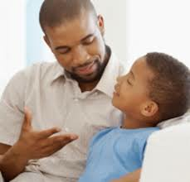

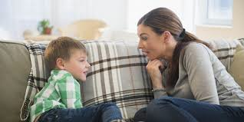
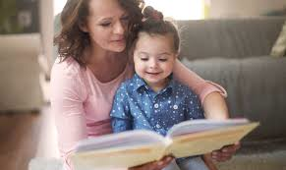
‘How can I help my child to be a good reader?’

Slide 51
My 10 Top Tips (in no particular order)

Slide 52
You can…
1. Play games and activities that promote reading,
e.g.
I spy
word-building games
board games
make a collection of things beginning with ‘s’
point out signs around you
notice letters on shops, adverts
link capital letters on signs and car registrations with the beginning of their own name
look out for tricky words – your teacher will give you a list

Slide 53
You can…
2. Create a love of reading by valuing books and the time spent reading together – it’s not for long!
Be enthusiastic about reading.
Make time to share a book.
Get cosy and comfortable.
Read books ‘just for fun’.

Slide 54
You can:
3. Be a good role model:
Let your child see you reading for pleasure or information.
When you read to your child, read with expression and pay attention to punctuation. Children will copy!

Slide 55
You can…
4. Talk about the texts, e.g.
What can you see in the pictures?
Who do you think that person might be?
Do you like this character? Why?
What might happen next? What makes you think that?
What is you favourite bit of the story? Why?
Did you like this book? Why?
Which is your favourite page? Why?
Test me - think of a question you can ask me about the text!

Slide 56
You can…
5. Extend your child’s vocabulary by teaching new words (both in texts and in conversation) and explaining what they mean.
Ask children to put them into a sentence.
Use them several times at home until they are embedded.

Slide 57
You can…
6. Interact with the text, e.g.
Make links with your own memories and experiences:
Do you remember when we went to the zoo and saw…?
Does that remind you of anything/ anywhere/ anyone?
Set challenges
Let’s find out about …
I bet you can’t find…
Can you find a word that means …

Slide 58
You can…
7. Build confidence and a love of books.
Read ‘with’ and ‘to’ your child as much as you can for as long as you can.
Re-read books – it builds confidence. Invite children to join in.
Praise, praise, praise – encourage and support – don’t pressurise or compare.
Read a variety of ‘texts’

Slide 59
You can…
8. Surround your child with books.
Visit the library – free access to books!
Charity shops and jumble sales are a good source of cheap books.
Swap books with friends.
Give books as presents and treats.

Slide 60
You can…
9. Develop Higher Order Reading Skills.
Location What did Baby Bear say?
Re-organisation What sort of a person is Goldilocks?
Inference How do you think BB felt?
Evaluation Do you think this is a good story?
Appreciation How did that story make you feel?
Predicting - What do you think will happen next?
Summarising – Can you tell me the story?

Slide 61
You can…
10. Develop comprehension skills in different ways.
Watch films linked to books and talk about the characters, their actions, the settings, etc.
Provide first-hand experiences, no matter how simple, and encourage talk, e.g. a walk in the autumn leaves or on the frosty grass. Encourage children to notice the world around them!

Slide 62
Developing fluency

Slide 63
Reread the whole sentence for fluency and meaning
The tin man sat on a pin.

Slide 64
“I don’t feel like reading.”
I’ll read to you today and then we’ll have a chat about it.
I’ll read a page then you read a page.
Let’s read in funny voices!
I’ll read the narrative and you read what the characters say.
Let’s record our reading and listen to it or send it to grandma.
Let’s read by torchlight.
Let’s set up a school and read a story to our ‘class’.

Slide 65
Reading in the 21st Century!
Books are still important!
Texts can also be electronic.
Films, video clips, pictures, photographs and paintings can also be discussed as ‘texts’ – take time to talk about these.

Slide 66
And finally...
A few words of wisdom!

Slide 67

Reading is a journey for life
– not a race to the finishing line!

