Slide 1
EYFS/Key Stage 1
Maths Workshop

Slide 2
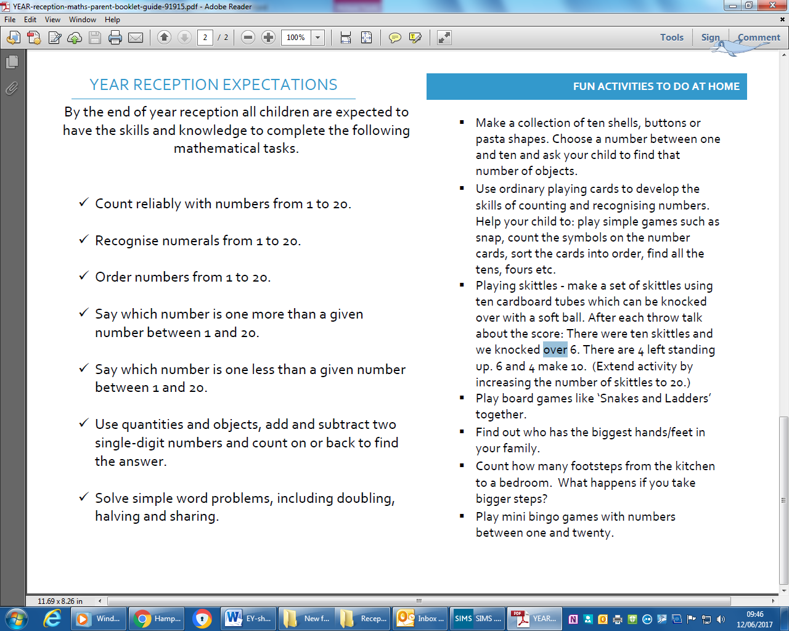

Slide 3
Year 1 – Number and Place Value
Pupils should be taught to:
count to and across 100, forwards and backwards, beginning with 0 or 1, or from any given number
count, read and write numbers to 100 in numerals; count in multiples of twos, fives and tens
given a number, identify one more and one less
identify and represent numbers using objects and pictorial representations including the number line, and use the language of: equal to, more than, less than (fewer), most, least
read and write numbers from 1 to 20 in numerals and words.

Slide 4
Year 1 – Addition and Subtraction
Pupils should be taught to:
read, write and interpret mathematical statements involving addition (+), subtraction (–) and equals (=) signs
represent and use number bonds and related subtraction facts within 20
add and subtract one-digit and two-digit numbers to 20, including zero
solve one-step problems that involve addition and subtraction, using concrete objects and pictorial representations, and missing number problems such as 7 = ? – 9.

Slide 5
Year 1 - Multiplication
Pupils should be taught to:
solve one-step problems involving multiplication and division, by calculating the answer using concrete objects, pictorial representations and arrays with the support of the teacher.

Slide 6
Year 1 - Fractions
Pupils should be taught to:
recognise, find and name a half as one of two equal parts of an object, shape or quantity
recognise, find and name a quarter as one of four equal parts of an object, shape or quantity.

Slide 7
Year 1 - Measure
Pupils should be taught to:
compare, describe and solve practical problems for:
lengths and heights [for example, long/short, longer/shorter, tall/short, double/half]
mass/weight [for example, heavy/light, heavier than, lighter than]
capacity and volume [for example, full/empty, more than, less than, half, half full, quarter]
time [for example, quicker, slower, earlier, later]
measure and begin to record the following:
lengths and heights
mass/weight
capacity and volume
time (hours, minutes, seconds)
recognise and know the value of different denominations of coins and notes
sequence events in chronological order using language [for example, before and after, next, first, today, yesterday, tomorrow, morning, afternoon and evening]
recognise and use language relating to dates, including days of the week, weeks, months and years
tell the time to the hour and half past the hour and draw the hands on a clock face to show these times.

Slide 8
Year 1 - Geometry
Pupils should be taught to:
recognise and name common 2-D and 3-D shapes, including:
2-D shapes [for example, rectangles (including squares), circles and triangles]
3-D shapes [for example, cuboids (including cubes), pyramids and spheres].
describe position, direction and movement, including whole, half, quarter and three-quarter turns.

Slide 9
Year 2 – Number and Place Value
Pupils should be taught to:
count in steps of 2, 3, and 5 from 0, and in tens from any number, forward and backward
recognise the place value of each digit in a two-digit number (tens, ones)
identify, represent and estimate numbers using different representations, including the number line
compare and order numbers from 0 up to 100; use <, > and = signs
read and write numbers to at least 100 in numerals and in words
use place value and number facts to solve problems.

Slide 10
Year 2 – Addition and Subtraction
Pupils should be taught to:
solve problems with addition and subtraction:
using concrete objects and pictorial representations, including those involving numbers, quantities and measures
applying their increasing knowledge of mental and written methods
recall and use addition and subtraction facts to 20 fluently, and derive and use related facts up to 100
add and subtract numbers using concrete objects, pictorial representations, and mentally, including:
a two-digit number and ones
a two-digit number and tens
two two-digit numbers
adding three one-digit numbers
show that addition of two numbers can be done in any order (commutative) and subtraction of one number from another cannot
recognise and use the inverse relationship between addition and subtraction and use this to check calculations and solve missing number problems.

Slide 11
Year 2 – Multiplication and Division
Pupils should be taught to:
recall and use multiplication and division facts for the 2, 5 and 10 multiplication tables, including recognising odd and even numbers
calculate mathematical statements for multiplication and division within the multiplication tables and write them using the multiplication (×), division (÷) and equals (=) signs
show that multiplication of two numbers can be done in any order (commutative) and division of one number by another cannot
solve problems involving multiplication and division, using materials, arrays, repeated addition, mental methods, and multiplication and division facts, including problems in contexts.

Slide 12
Year 2 - Fractions
Pupils should be taught to:
recognise, find, name and write fractions 1/3, 1/4, 2/4 and 3/4 of a length, shape, set of objects or quantity
write simple fractions for example, ½ of 6 = 3 and recognise the equivalence of 2/4 and 1/2.

Slide 13
Year 2 - Measure
Pupils should be taught to:
choose and use appropriate standard units to estimate and measure length/height in any direction (m/cm); mass (kg/g); temperature (°C); capacity (litres/ml) to the nearest appropriate unit, using rulers, scales, thermometers and measuring vessels
compare and order lengths, mass, volume/capacity and record the results using >, < and =
recognise and use symbols for pounds (£) and pence (p); combine amounts to make a particular value
find different combinations of coins that equal the same amounts of money
solve simple problems in a practical context involving addition and subtraction of money of the same unit, including giving change
compare and sequence intervals of time
tell and write the time to five minutes, including quarter past/to the hour and draw the hands on a clock face to show these times
know the number of minutes in an hour and the number of hours in a day.

Slide 14
Year 2 - Geometry
Pupils should be taught to:
identify and describe the properties of 2-D shapes, including the number of sides and line symmetry in a vertical line
identify and describe the properties of 3-D shapes, including the number of edges, vertices and faces
identify 2-D shapes on the surface of 3-D shapes [for example, a circle on a cylinder and a triangle on a pyramid]
compare and sort common 2-D and 3-D shapes and everyday objects.
order and arrange combinations of mathematical objects in patterns and sequences
use mathematical vocabulary to describe position, direction and movement, including movement in a straight line and distinguishing between rotation as a turn and in terms of right angles for quarter, half and three-quarter turns (clockwise and anti-clockwise).

Slide 15
Year 2 - Statistics
Pupils should be taught to:
interpret and construct simple pictograms, tally charts, block diagrams and simple tables
ask and answer simple questions by counting the number of objects in each category and sorting the categories by quantity
ask and answer questions about totalling and comparing categorical data.

Slide 16
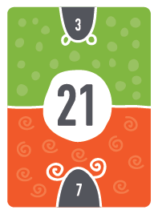
Froggy Maths
Helps to learn their Times Tables
Sheets are found on the website if you need to look at them.
Beneficial to learn the inverse also.
Spend time each day doing quick fire questions.
If children know their two times tables then they actually know 25% of the times tables!
If they know their 2s, 5s and 10s then they 53% of their times tables.
In Year 1 it is about counting in steps but in Year 2 it is about quick recall.
The FunKey Maths cards are excellent for supporting your children with this.
https://www.funkeymaths.com/

Slide 17
Mastery of Maths
Able to explain how they found their answers
Use accurate vocabulary when giving explanations
Used a range of strategies to problem solve
Decided on the most efficient strategy to use
Able to apply skills across the curriculum

Slide 18
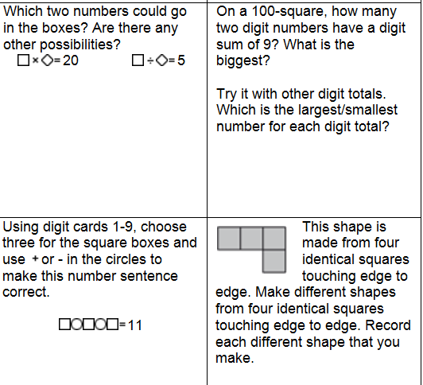
Reasoning Questions

Slide 19
Opportunity for questions…
There are several members of staff to ask individual questions to if you wish.
There are last year’s SATs papers for the end of KS1 to look at.
Times tables cards to look at.
Resources we use in school to give you ideas.

