Slide 1
Key Stage 2
Maths Workshop

Slide 2
AIMS OF THE NATIONAL CURRICULUM
The national curriculum for mathematics aims to ensure that all pupils:
become fluent in the fundamentals of mathematics, including through varied and frequent practice with increasingly complex problems over time, so that pupils develop conceptual understanding and the ability to recall and apply knowledge rapidly and accurately.
reason mathematically by following a line of enquiry, conjecturing relationships and generalisations, and developing an argument, justification or proof using mathematical language
can solve problems by applying their mathematics to a variety of routine and non-routine problems with increasing sophistication, including breaking down problems into a series of simpler steps and persevering in seeking solutions.

Slide 3
Year 3 – Number and Place Value
Pupils should be taught to:
count from 0 in multiples of 4, 8, 50 and 100; find 10 or 100 more or less than a given number
recognise the place value of each digit in a three-digit number (hundreds, tens, ones)
compare and order numbers up to 1000
identify, represent and estimate numbers using different representations
read and write numbers up to 1000 in numerals and in words
solve number problems and practical problems involving these ideas.

Slide 4
Year 4 – Number and Place Value
Pupils should be taught to:
count in multiples of 6, 7, 9, 25 and 1000
find 1000 more or less than a given number
count backwards through zero to include negative numbers
recognise the place value of each digit in a four-digit number (thousands, hundreds, tens, and ones)
order and compare numbers beyond 1000
identify, represent and estimate numbers using different representations
round any number to the nearest 10, 100 or 1000
solve number and practical problems that involve all of the above and with increasingly large positive numbers
read Roman numerals to 100 (I to C) and know that over time, the numeral system changed to include the concept of zero and place value.

Slide 5
Year 5 – Number and Place Value
Pupils should be taught to:
read, write, order and compare numbers to at least 1 000 000 and determine the value of each digit
count forwards or backwards in steps of powers of 10 for any given number up to 1 000 000
interpret negative numbers in context, count forwards and backwards with positive and negative whole numbers, including through zero
round any number up to 1 000 000 to the nearest 10, 100, 1000, 10 000 and 100 000
solve number problems and practical problems that involve all of the above
read Roman numerals to 1000 (M) and recognise years written in Roman numerals.

Slide 6
Year 6 – Number and Place Value
Pupils should be taught to:
read, write, order and compare numbers up to 10 000 000 and determine the value of each digit
round any whole number to a required degree of accuracy
use negative numbers in context, and calculate intervals across zero
solve number and practical problems that involve all of the above.

Slide 7
Year 3 – Addition and Subtraction
Pupils should be taught to:
add and subtract numbers mentally, including:
a three-digit number and ones
a three-digit number and tens
a three-digit number and hundreds
add and subtract numbers with up to three digits, using formal written methods of columnar addition and subtraction
estimate the answer to a calculation and use inverse operations to check answers
solve problems, including missing number problems, using number facts, place value, and more complex addition and subtraction.

Slide 8
Year 4 – Addition and Subtraction
Pupils should be taught to:
add and subtract numbers with up to 4 digits using the formal written methods of columnar addition and subtraction where appropriate
estimate and use inverse operations to check answers to a calculation
solve addition and subtraction two-step problems in contexts, deciding which operations and methods to use and why.

Slide 9
Year 5 – Addition and Subtraction
Pupils should be taught to:
add and subtract whole numbers with more than 4 digits, including using formal written methods (columnar addition and subtraction)
add and subtract numbers mentally with increasingly large numbers
use rounding to check answers to calculations and determine, in the context of a problem, levels of accuracy
solve addition and subtraction multi-step problems in contexts, deciding which operations and methods to use and why.

Slide 10
Year 3 – Multiplication and Division
Pupils should be taught to:
recall and use multiplication and division facts for the 3, 4 and 8 multiplication tables
write and calculate mathematical statements for multiplication and division using the multiplication tables that they know, including for two-digit numbers times one-digit numbers, using mental and progressing to formal written methods
solve problems, including missing number problems, involving multiplication and division, including positive integer scaling problems and correspondence problems in which n objects are connected to m objects.

Slide 11
Year 4 – Multiplication and Division
Pupils should be taught to:
recall multiplication and division facts for multiplication tables up to 12 × 12
use place value, known and derived facts to multiply and divide mentally, including: multiplying by 0 and 1; dividing by 1; multiplying together three numbers
recognise and use factor pairs and commutativity in mental calculations
multiply two-digit and three-digit numbers by a one-digit number using formal written layout
solve problems involving multiplying and adding, including using the distributive law to multiply two digit numbers by one digit, integer scaling problems and harder correspondence problems such as n objects are connected to m objects.

Slide 12
Year 5 – Multiplication and Division
Pupils should be taught to:
identify multiples and factors, including finding all factor pairs of a number, and common factors of two numbers
know and use the vocabulary of prime numbers, prime factors and composite (non-prime) numbers
establish whether a number up to 100 is prime and recall prime numbers up to 19
multiply numbers up to 4 digits by a one- or two-digit number using a formal written method, including long multiplication for two-digit numbers
multiply and divide numbers mentally drawing upon known facts
divide numbers up to 4 digits by a one-digit number using the formal written method of short division and interpret remainders appropriately for the context
multiply and divide whole numbers and those involving decimals by 10, 100 and 1000

Slide 13
Year 6 – Addition, Subtraction, Multiplication and Division
Pupils should be taught to:
multiply multi-digit numbers up to 4 digits by a two-digit whole number using the formal written method of long multiplication
divide numbers up to 4 digits by a two-digit whole number using the formal written method of long division, and interpret remainders as whole number remainders, fractions, or by rounding, as appropriate for the context
divide numbers up to 4 digits by a two-digit number using the formal written method of short division where appropriate, interpreting remainders according to the context
perform mental calculations, including with mixed operations and large numbers
identify common factors, common multiples and prime numbers
use their knowledge of the order of operations to carry out calculations involving the four operations
solve addition and subtraction multi-step problems in contexts, deciding which operations and methods to use and why
solve problems involving addition, subtraction, multiplication and division
use estimation to check answers to calculations and determine, in the context of a problem, an appropriate degree of accuracy.

Slide 14
Year 3 - Fractions
Pupils should be taught to:
count up and down in tenths; recognise that tenths arise from dividing an object into 10 equal parts and in dividing one-digit numbers or quantities by 10
recognise, find and write fractions of a discrete set of objects: unit fractions and non-unit fractions with small denominators
recognise and use fractions as numbers: unit fractions and non-unit fractions with small denominators
recognise and show, using diagrams, equivalent fractions with small denominators
add and subtract fractions with the same denominator within one whole compare and order unit fractions, and fractions with the same denominators
solve problems that involve all of the above.

Slide 15
Year 4 – Fractions and Decimals
Pupils should be taught to:
recognise and show, using diagrams, families of common equivalent fractions
count up and down in hundredths; recognise that hundredths arise when dividing an object by one hundred and dividing tenths by ten.
solve problems involving increasingly harder fractions to calculate quantities, and fractions to divide quantities, including non-unit fractions where the answer is a whole number
add and subtract fractions with the same denominator
recognise and write decimal equivalents of any number of tenths or hundredths
recognise and write decimal equivalents to , ,
find the effect of dividing a one- or two-digit number by 10 and 100, identifying the value of the digits in the answer as ones, tenths and hundredths
round decimals with one decimal place to the nearest whole number
compare numbers with the same number of decimal places up to two decimal places
solve simple measure and money problems involving fractions and decimals to two decimal places.

Slide 16
Year 5 - Fractions
Pupils should be taught to:
compare and order fractions whose denominators are all multiples of the same number
identify, name and write equivalent fractions of a given fraction, represented visually, including tenths and hundredths
recognise mixed numbers and improper fractions and convert from one form to the other
multiply proper fractions and mixed numbers by whole numbers, supported by materials and diagrams
read and write decimal numbers as fractions recognise and use thousandths and relate them to tenths, hundredths and decimal equivalents
round decimals with two decimal places to the nearest whole number and to one decimal place
read, write, order and compare numbers with up to three decimal places
solve problems involving number up to three decimal places
recognise the per cent symbol (%) and understand that per cent relates to ‘number of parts per hundred’, and write percentages as a fraction with denominator 100, and as a decimal
solve problems which require knowing percentage and decimal equivalents

Slide 17
Year 6 - Fractions
Pupils should be taught to:
use common factors to simplify fractions; use common multiples to express fractions in the same denomination
compare and order fractions
add and subtract fractions with different denominators and mixed numbers, using the concept of equivalent fractions
multiply simple pairs of proper fractions, writing the answer in its simplest form
divide proper fractions by whole numbers
identify the value of each digit in numbers given to three decimal places and multiply and divide numbers by 10, 100 and 1000 giving answers up to three decimal places
multiply one-digit numbers with up to two decimal places by whole numbers
use written division methods in cases where the answer has up to two decimal places
solve problems which require answers to be rounded to specified degrees of accuracy
recall and use equivalences between simple fractions, decimals and percentages, including in different contexts.

Slide 18
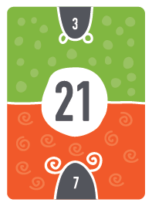
Froggy Maths
Helps to learn their Times Tables
Sheets are found on the website if you need to look at them.
Beneficial to learn the inverse also.
Spend time each day doing quick fire questions.
If children know their two times tables then they actually know 25% of the times tables!
If they know their 2s, 3s, 4s, 5s, 8s and 10s then they know 80% of their times tables.
The FunKey Maths cards are excellent for supporting your children with this.
https://www.funkeymaths.com/

Slide 19
Mastery of Maths
Able to explain how they found their answers
Use accurate vocabulary when giving explanations
Used a range of strategies to problem solve
Decided on the most efficient strategy to use
Able to apply skills across the curriculum

Slide 20
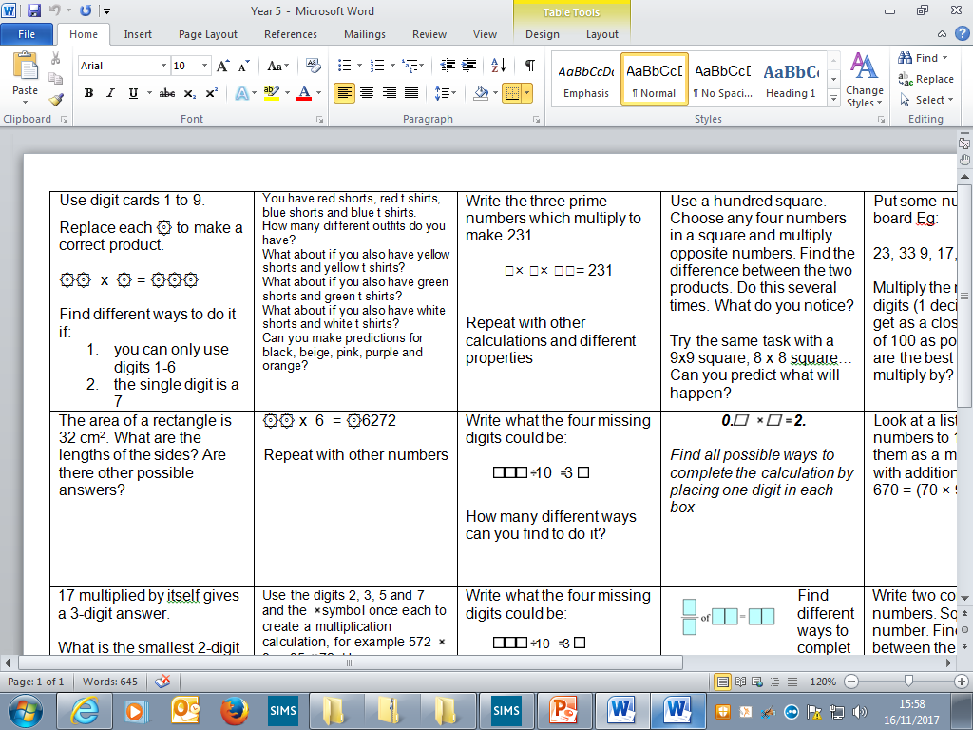
Reasoning Questions

Slide 21
Opportunity for questions…
There are several members of staff to ask individual questions to if you wish.
There are last year’s SATs papers for the end of KS2 to look at.
Times tables cards to look at.

